Slide 1
Build Universal Windows Platform Apps with the Microsoft Graph
Build UWP app using Microsoft Graph .NET SDK

Slide 2

Building Microsoft Graph applications
Intro to the Microsoft Graph API
Getting started
UWP overview
Creating an UWP application for Azure AD & Microsoft Graph

Slide 3
Developer vision
USERS
DATA
HTML
Notes:
Our Office 365 developer vision focuses on the Users’ experience and their data. As a developer you can bring your applications into their user experience. With over 1.2+ billion users of Office Worldwide, this is a huge opportunity to provide a window into your applications. As well as being able to connect into their data and add intelligence to your applications. There are currently 850 million events created a month and a total of 470Pb+ of data stored in the service that can add value to for our Users’.

Slide 4
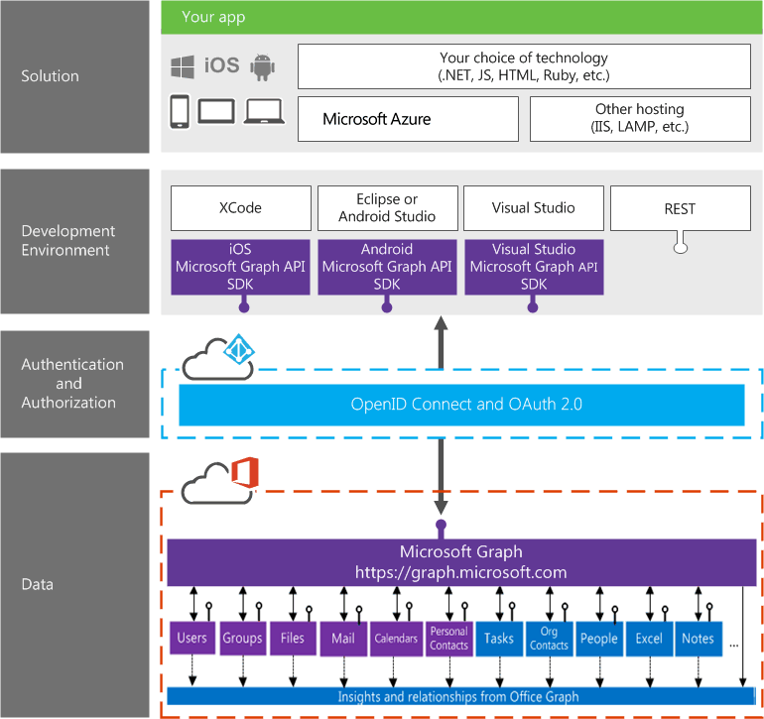
Building integration with Office 365

Slide 5
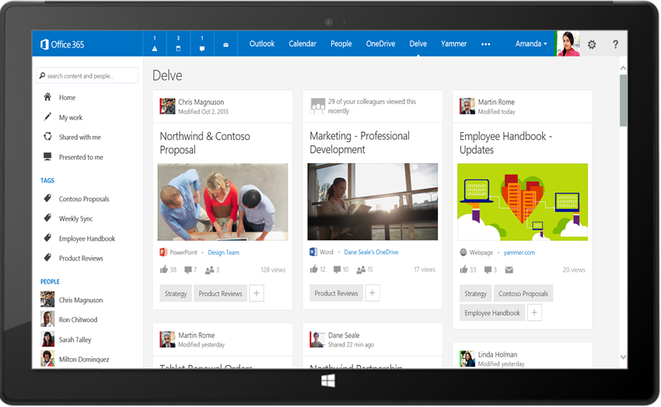
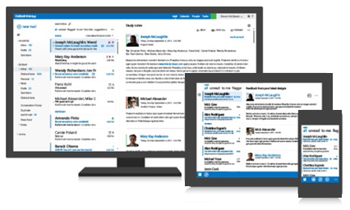




Microsoft Graph API
Your App
https://graph.microsoft.com/
USERS
GROUPS
FILES
MAIL
CALENDAR
TASKS
Insights and relationships from Office Graph

Slide 6
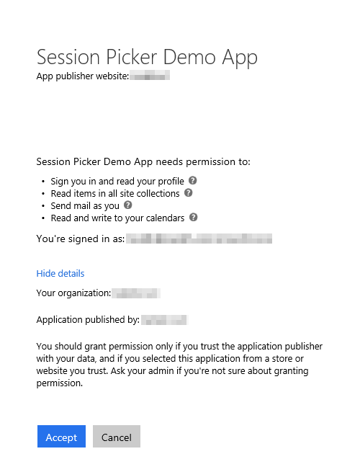
Azure AD OAuth in Office 365
Single authentication flow
Across all Office 365 services
“Native” apps and web sites
Admin and end-user consent
Secure protocol
OAuth 2.0 (no capturing user credentials)
Fine-grained access scopes
Supports MFA and federated user sign-in
Long-term access through refresh tokens
Unique considerations of “Native” Azure Apps
Inherently multi-tenant
No client/app secret (think about distribution)
Leverage a web authentication window/broker
Notes:
The Microsoft Graph leverages Azure AD, like so many other cloud services from Microsoft, for authentication and authorization
You can create web apps as well as native apps with Azure AD apps
In addition, users can authorize the application using delegated consent (where they grant the application to act on their behalf)
Global tenant admins can also grant consent to all users as a different type of consent (Admin Consent)
Azure AD app authentication implemented using OAuth 2.0 protocol
Users are redirected to Azure for authentication so custom applications never get the credentials
Depending on the authentication flow leveraged, the app ultimately gets an access token that’s only valid for a set amount of time, for a specific user, with specific permissions and for a specific resource (ie: Microsoft Graph)
These access tokens can be refreshed after expiration using an associated refresh token
This login process also supports MFA & federated authentication
Native applications differ from web applications in a few ways:
They are multi-tenant by default
You don’t need to worry about app secrets as when the native app is distributed, it can’t contain a secret … because it’s no longer a secret
Instead you use special redirect URIs

Slide 7
Single authentication flow for Office 365
Sign users in using OpenID Connect
Azure AD and Office 365 services
Supports MFA and federated user sign-in
Device apps, web sites, SPAs, and service apps
Pin apps to Office 365 app launcher from My apps
Notes:
All Office 365 cloud services, including SharePoint Online, and Microsoft Graph, leverage Azure AD for authentication and authorization
This means there is a single authentication flow to use Office 365 applications as well as those created to leverage the Microsoft Graph

Slide 8
A bigger opportunity with one Windows…
Xbox 360
Xbox One
Unified core
Unified app platform
One Store
Converged
OS kernel
Windows 8
Windows 8.1
Converged
app model
Windows Phone 8.1
Windows Phone 8
Easy for users to get and stay current
Windows Phone 7.5
Windows on devices
Notes:
Platform convergence has been a journey which ends today with Windows 10
We started by using the same Internet Explorer code + engine on Windows Phone 7.5 and Xbox 360; and we started implementing the Microsoft modern design language.
With the release of Windows 8, we converged the Windows kernel (which aligns, among other things, the HAL and driver models). Windows Phone 8 took advantage of new lighter-weight kernel to enable multiple CPUs and other improvements, and the Xbox One was built on top of Windows 8. Xbox also introduced xJS, Xbox’s version of WinJS so developers could write apps in HTML/WinJS the same framework as available on Windows 8.
With the release of Windows Phone 8.1 the runtimes from Windows 8.1 and phone came together as well – continuing up the Windows stack and building upon the kernel convergence that happened in 8.0 – aligning the app models and API set, bringing 90%+ API convergence and unification/convergence of things like Windows Notification Services, back-stack behavior, sharing contracts, live tiles, etc.
With Windows 10, we bring complete the unification of Windows families, and now provide a Windows core that can be used on embedded and IoT devices.
Background data:
9/15/11 Windows Phone 7.5
10/26/12 Windows 8
10/29/12 Windows Phone 8
10/18/13 Windows 8.1
11/22/13 Xbox One
4/8/14 Windows 8.1 Update
3/26/14 Windows Phone 8.1

Slide 9
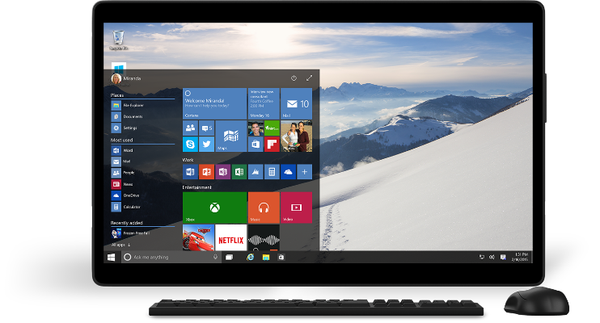
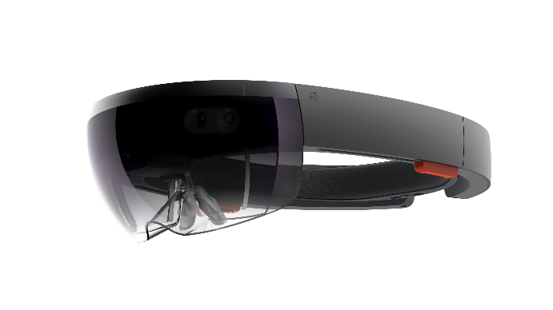
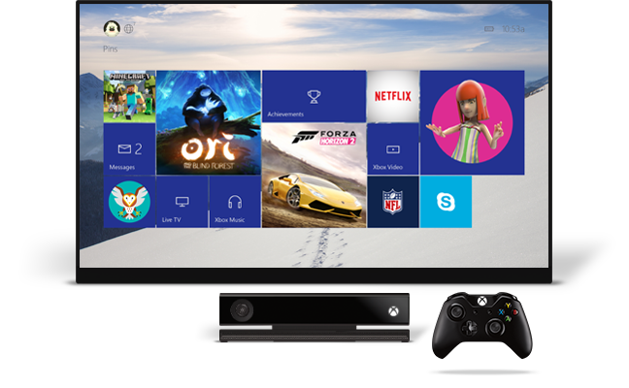
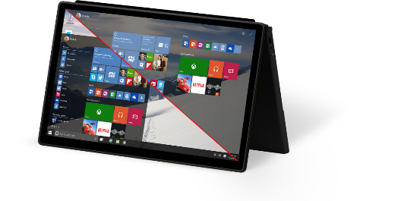
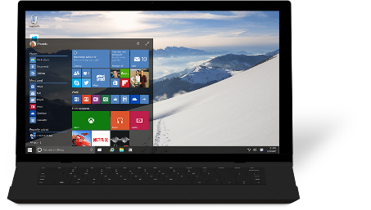
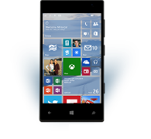
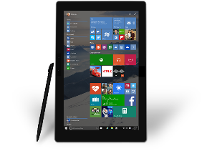
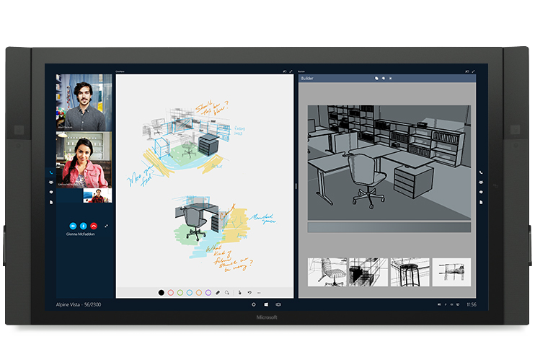
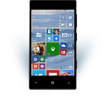
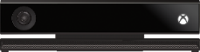









…and one app platform
Universal Windows platform
PC
Holographic
Mobile
Console
Devices +IoT
Surface Hub
Adaptive user interface
Full support for existing code
Natural user inputs
One store + one dev center
SDK + services
Notes:
To bring the family together, Windows 10 is built upon a unified core (the Windows core) and a unified app platform (Universal Windows platform), meaning that all of our device families run Windows at their core. This provides the consistency that users need and the tailored experiences desire.
Gone are the days of Microsoft maintaining a number of code-bases that works to build bridges across silos; Windows has evolved to do that itself. And gone are the days of ISVs doing this as well – targeting Windows provides a single roadmap to the billion+ Windows screens.
Enabling this consistent, yet tailored, Windows experience are a number of services:
Adaptive UX: User interface design that adapts and reacts to the device family it’s running on
Natural user inputs: Speech, natural ink, gesture and facial recognition
Cloud-based intelligent services: Cortana AI, personal hubs, OneDrive, Office 365, Windows notification services, credential locker
Windows Store: Universally available apps and games, digital media
For the app builder, this also means that you can build one Windows solution that runs across all of the Windows device families, and use these Windows services to tailor your experience at runtime.

Slide 10
Tuned to each form factor
Windows for PCs
Familiar desktop shell
Broad hardware ecosystem
Windows desktop application compatibility
Windows for phones
Familiar mobile shell
Rich telephony
Windows Phone app compatibility
Windows on Xbox
10’ shell experience
Shared gaming experiences
Game and app compatibility
Windows for…
Form factor-appropriate shell experience
Device-specific scenario support
One core OS
Base OS
App and device platform
Runtimes and frameworks
http://dev.office.com/

Slide 11
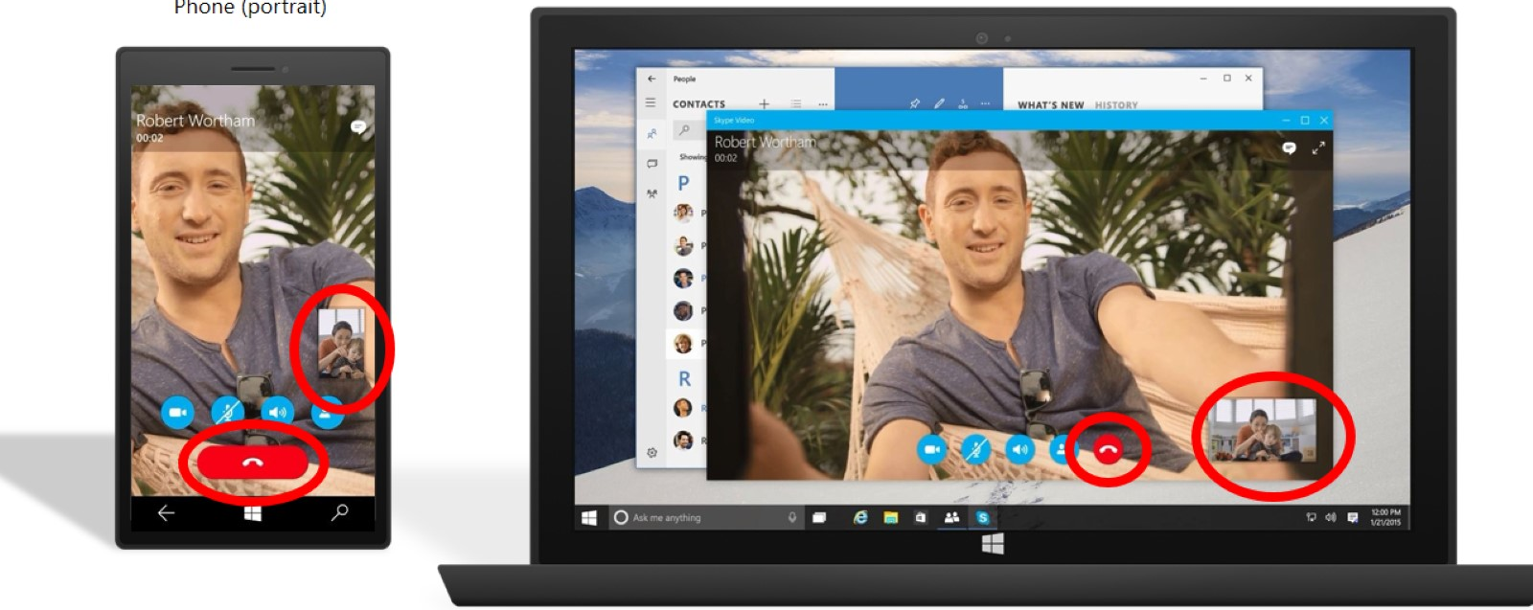
Adaptive UX Same code, same controls, optimized layout
Tablet (landscape)/desktop
Phone (portrait)

Slide 12
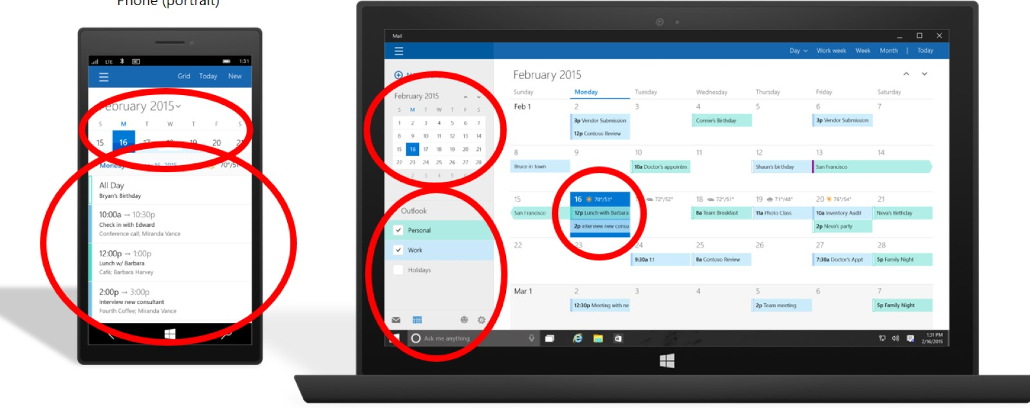
Tailored experiences Based on a set of adaptive control and enable an experience tailored to the device
Tablet (landscape)/desktop
Phone (portrait)

Slide 13
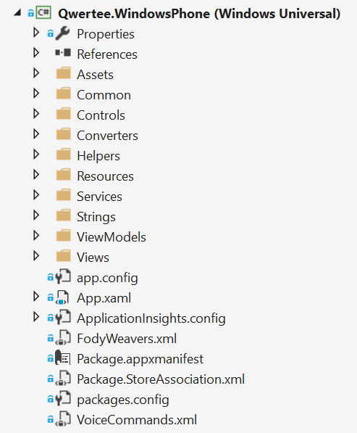
One binary for every device
No more shared project and specific platforms project
No more conditional code
Only one store
The Universal Windows Platform is available on every Windows 10 device

Slide 14
Universal Windows Platform
It’s a collection of contracts and extensions
When you create an app you target a version of the UWP, not of the operating system
<Dependencies>
<TargetDeviceFamily Name="Windows.Universal" MinVersion="10.0.10069.0" MaxVersionTested="10.0.10166.0" />
</Dependencies>

Slide 15
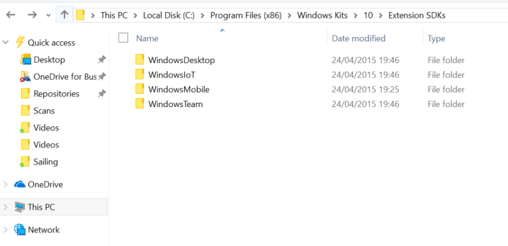
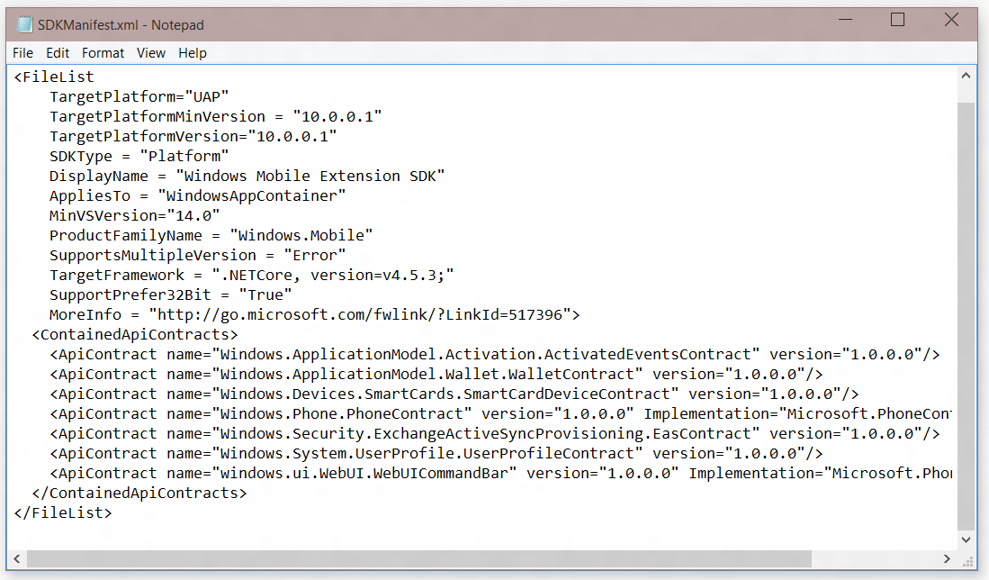
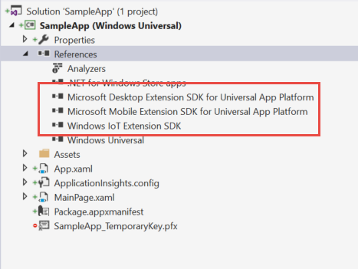
Platform extensions
SDKs to add specific platform APIs on top of the Universal Windows Platform

Slide 16
Creating a UWP application

Slide 17
Process of Creating a UWP application
Create the application using Visual Studio
Implement the user experience
Extend the app to support authentication and token acquisition from Azure AD
Integrate the Microsoft Graph .NET SDK SDK

Slide 18
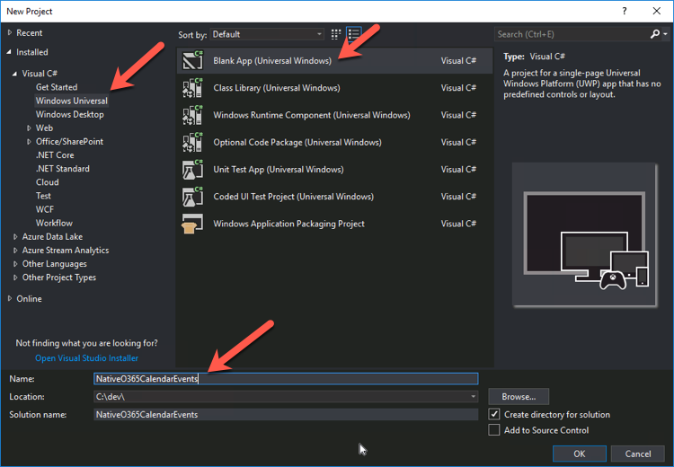
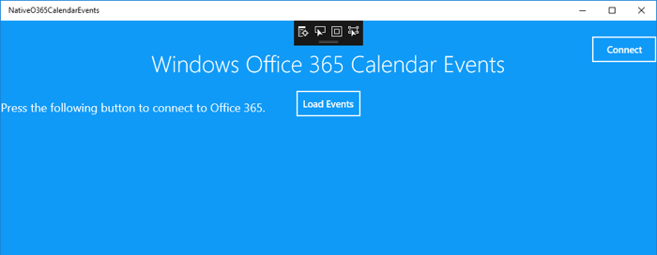
Create Universal Windows Platform Applications
Create the application using Visual Studio
Implement User Interface
Test application prior to implementing authentication & integrating Microsoft Graph

Slide 19
Demo

Slide 20
Thank you.

